Slide 1

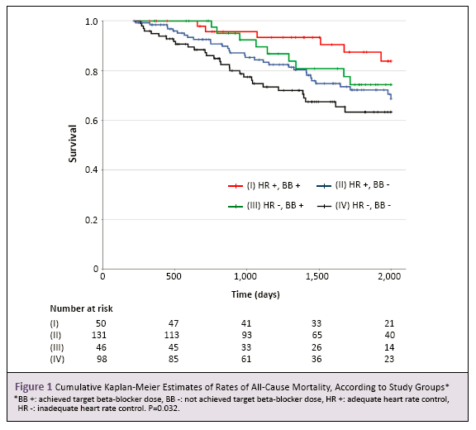
Please use font Arial, size 40 for abstract title.
Please use font Arial, size 23 for the names and affiliations of all authors
Please use font Arial, size 23 for the names and affiliations of all authors
Purpose
……
Methods
……
Results
……
Conclusions
……

